Slide 1
Setting up Serial EM for single particle cryoEM data collection
Zongli
Nov. 29, 2017

Slide 2
Goal:
After the training, one should be able to follow through to set up SEM for data collection
Settings used in this training are for FEI Tecnai Polara G2

Slide 3
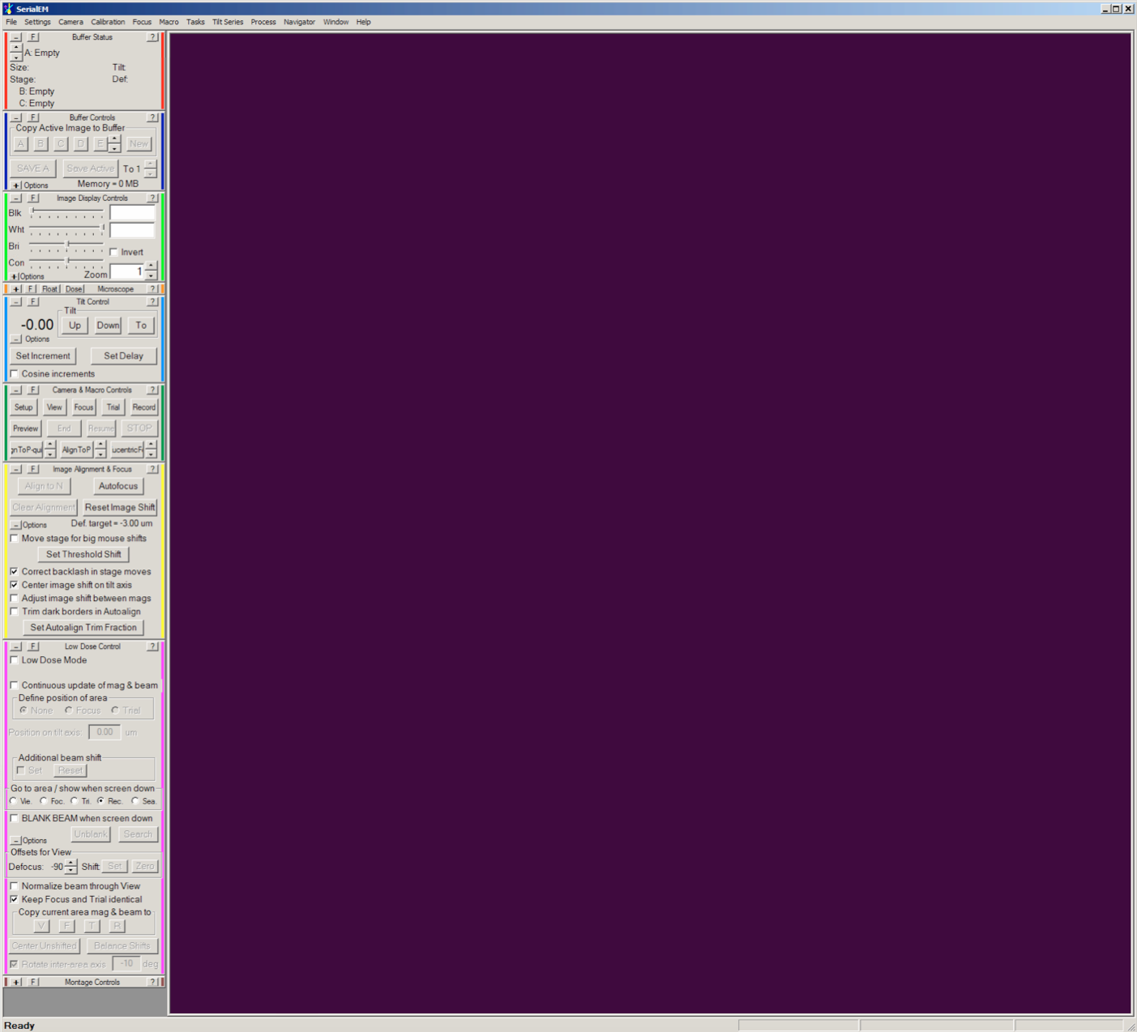
Introduction to the GUI
Menus
Control panels
Display area
Status bar

Slide 4
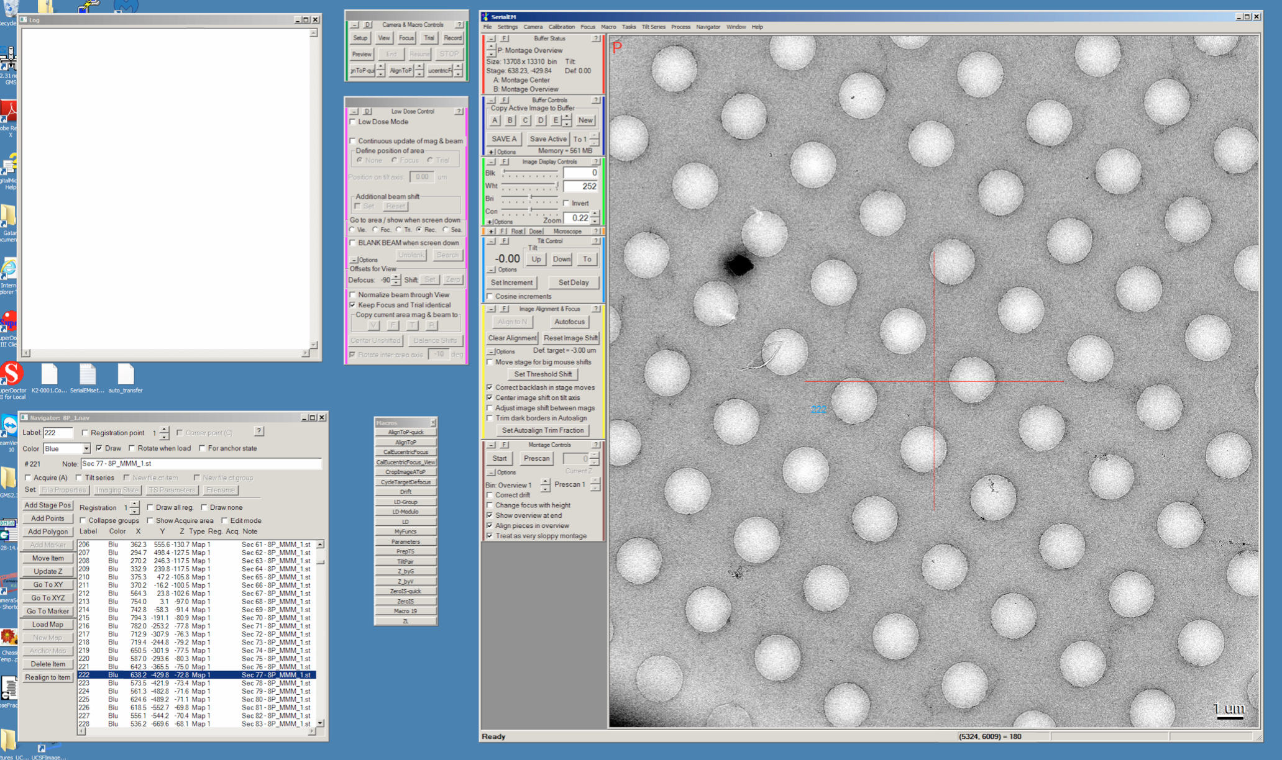
Introduction to the GUI
Camera & micro controls
Log window
Low Dose conrol
display window
Microns
Navigator window

Slide 5
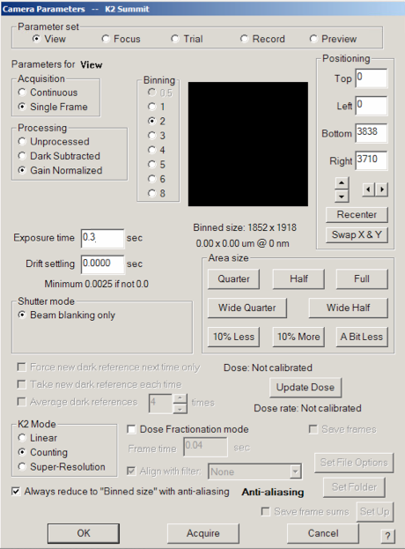
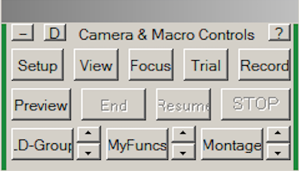
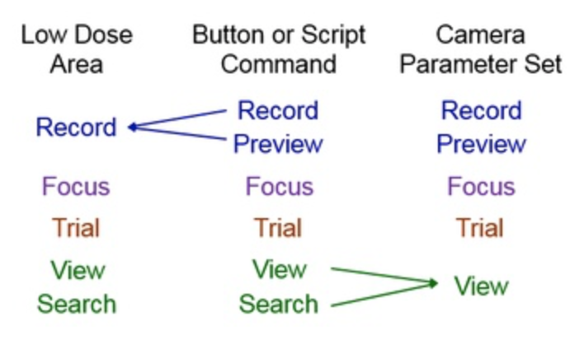



Set up camera parameters
Setting up camera parameters for each mode on Camera & Macro Controls panel
  Click “Setup” button, this will bring up a new window
  Set up parameters for each mode:
    View – Counting, 2x bin, 0.3 s
    Focus – Counting, 4x bin, 0.3 s
    Trial – Same as focus
    Record – Super resolution, 0.5x bin, 10 s with dose-fractionation, sub-frame time 200~300 ms
    Preview– Counting, 2x bin, 4 s

Slide 6
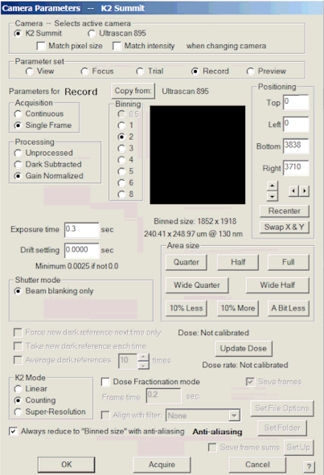
Acquire Low Mag Montage
Procedure:
Microscope settings:
      Mag: 58x (screen up)
      Obj. aperture out
  C2 lens aperture: 120 μm (the largest one
  installed now)
  Spot size: 9
Camera settings (Record):
      Counting mode
      2x binning
  Exposure time: 0.3 s
Setting up full montage
  Start SEM from your own folder
  Low Dose is off
  Open a new navigator window
    Navigator
  Set up a full montage
    Navigator
    Set up a full montage
      Click the Start button on Montage control panel to start
open

Slide 7
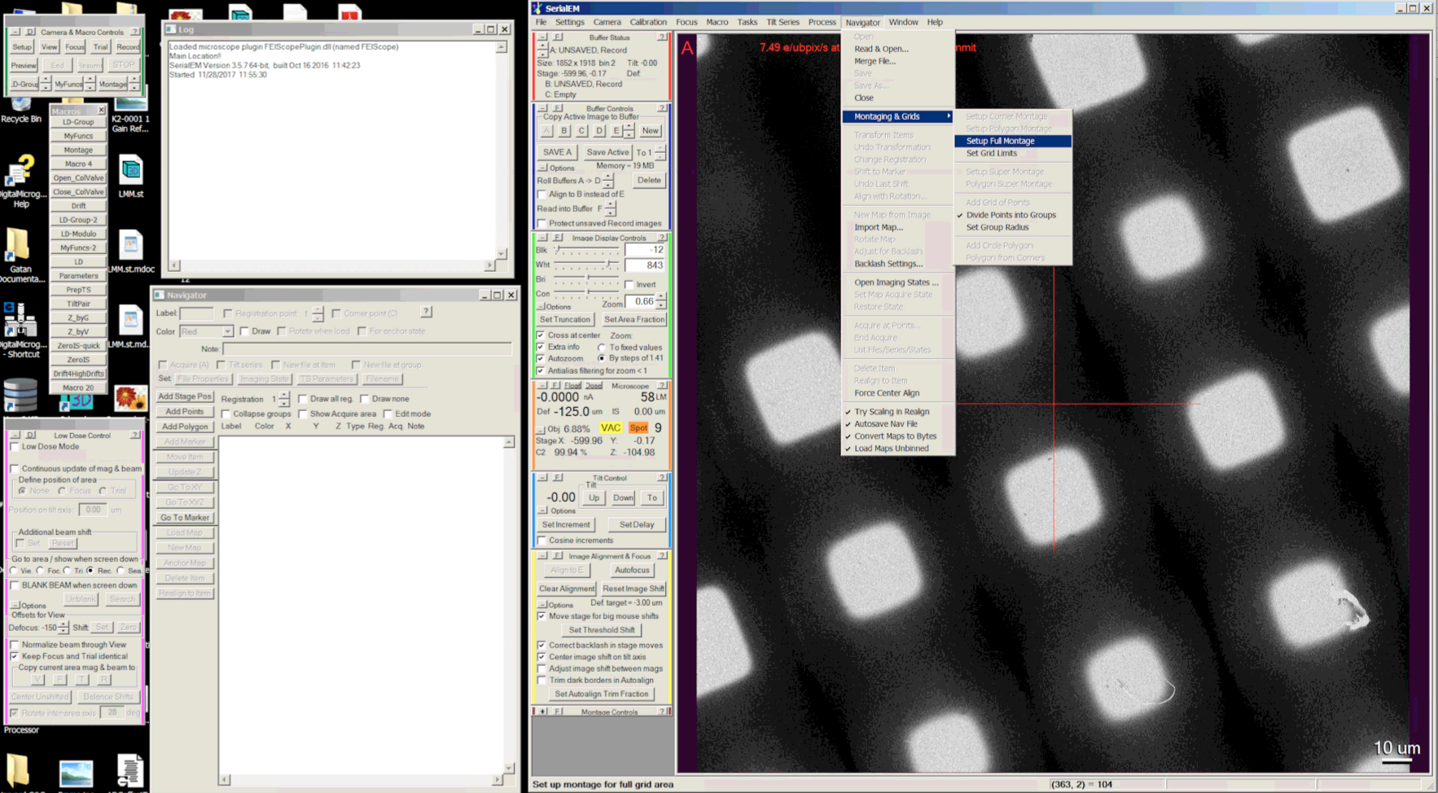

Slide 8
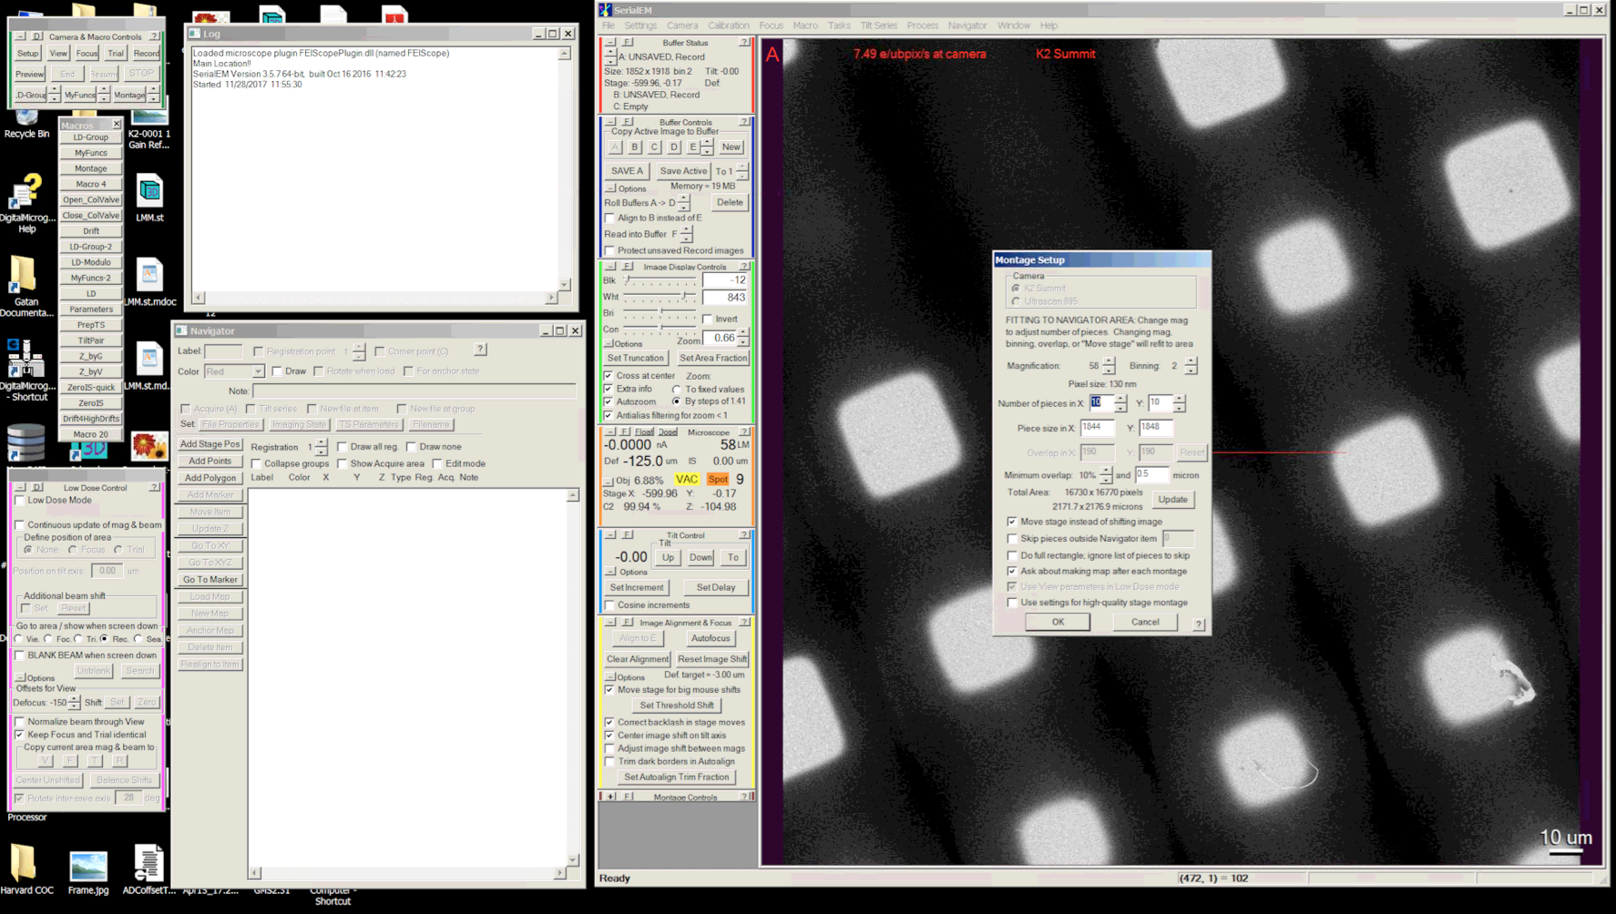
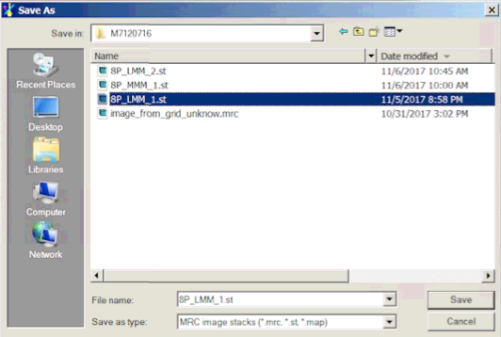
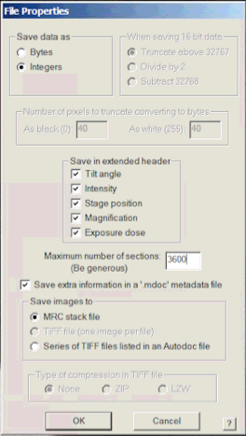
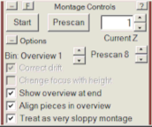

Slide 9
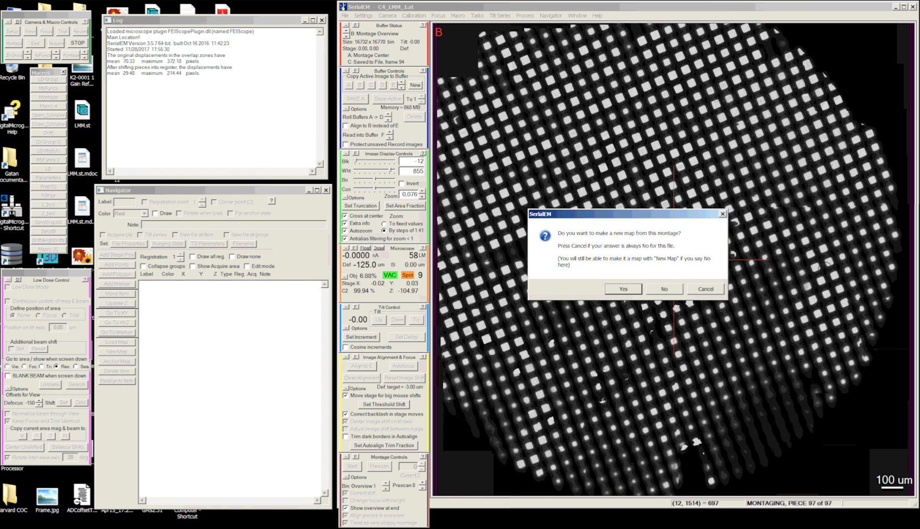
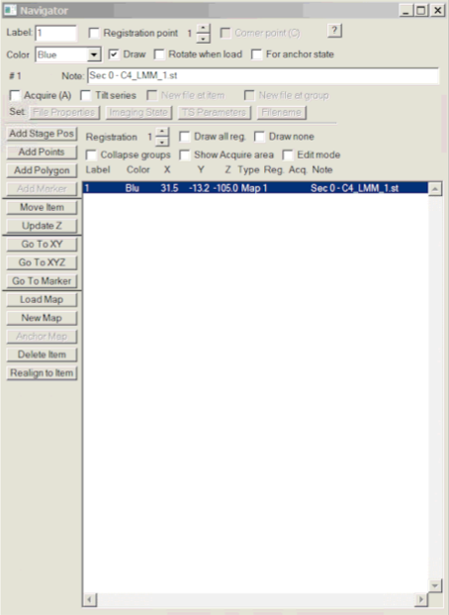

Slide 10
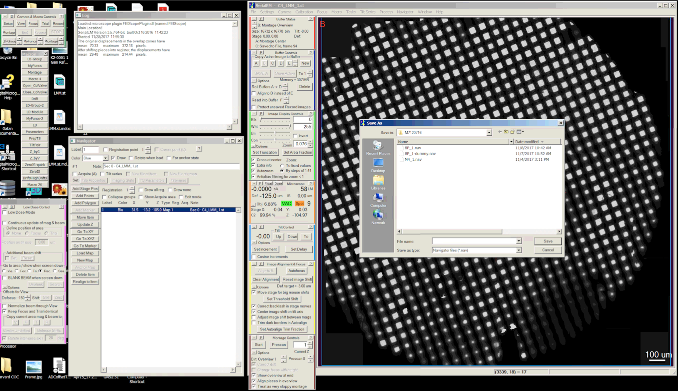

Slide 11
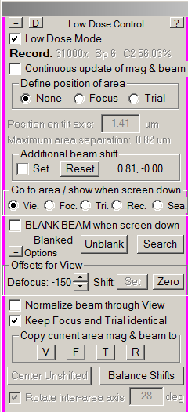
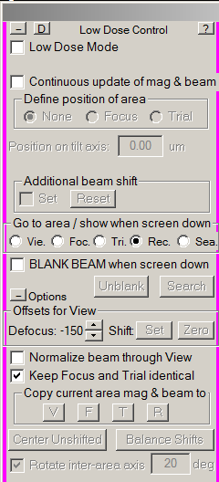
Setting up LowDose
Procedure (on Low Dose Control” panel):
  Turn on LowDose by checking the “Low Dose Mode”
  Check the “Continuous update of mag & beam”
  Set up the “Rec” beam first:
    Set the Mag and spot size
    31000x, spot size 6 (Polara)
    Check beam in Direct alignment
    Adjust intensity and center it
  Set up the “Vie” beam:
    Check the “Set” in Additional beam shift
    Set the Mag and spot size
    2300x, spot size 6 (Polara)
    Adjust intensity and center it

Slide 12
Setting up LowDose (Cont.)
Procedure (Cont.)
  Set up the “Foc.” beam
    Check the “Keep Focus and Trial identical”
    Note: In single particle data collection, we don’t really need the trial, it is really for tracking in tomography data acquisition
    Same Mag. and spot size as “Rec.”
    Check the “Set” in “Additional beam shift”
    Adjust intensity and center the beam
  Re-check the beam for “Rec.”
    Make sure the “Set” is un-checked in additional beam shift
    Adjust intensity and center the beam
  Re-check the beam for “Vie.” and “Foc.” with “Set” checked in additional beam shift
  Repeat above steps until satisfied
  Un-check the “Continuous update of mag & beam

Slide 13
Align the view mode with Low Mag Montage
It’s essential to record media mag montage in correct locations procedure:
  Find a feature on the low mag montage that could be recognized on view mode
  Add a point on that feature
  Navigator
          Add points
      Click on the feature to add a point, and then click the “Stop Adding” to finish
  Take a view image that have the feature on it
  Add a marker on the feature on the view image
  From Navigator click the “Shift to marker”
    You will see the coordinates of all the items on Navigator will change

Slide 14
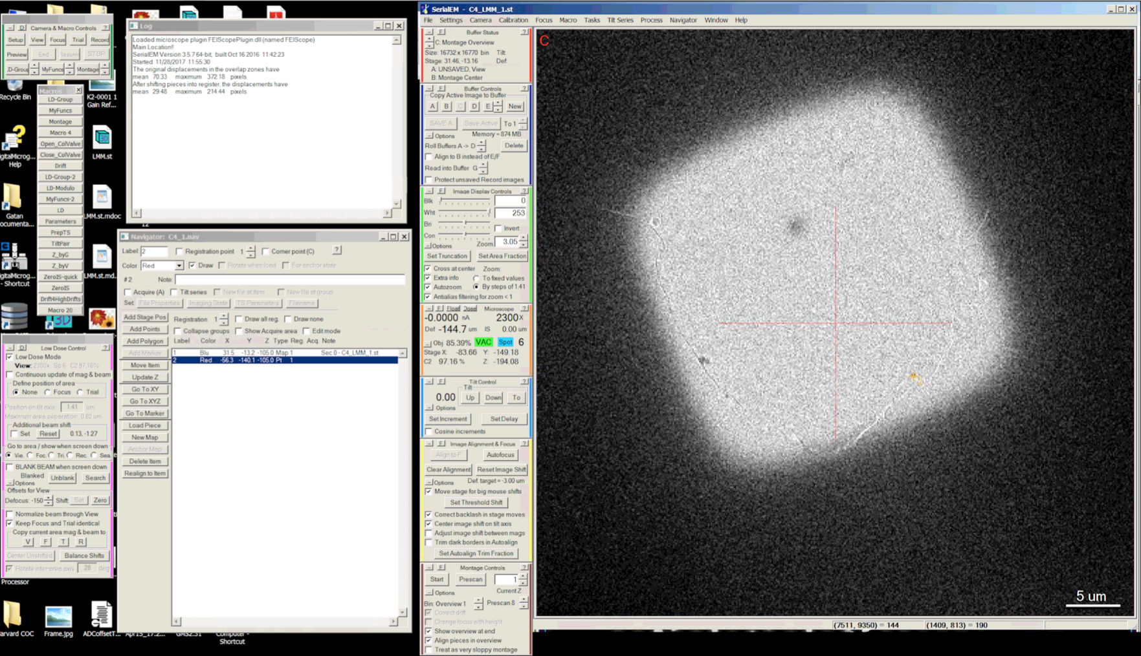
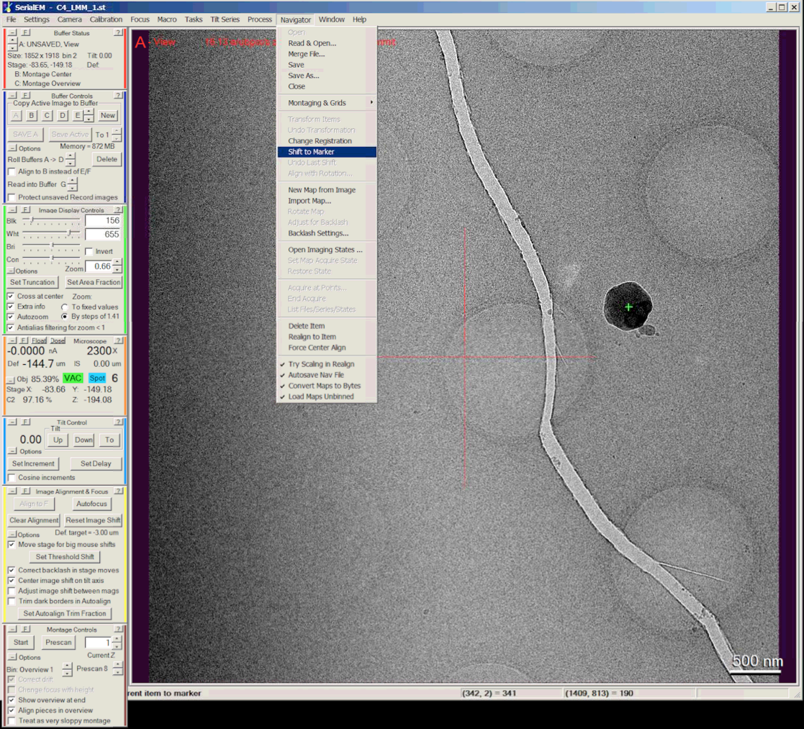
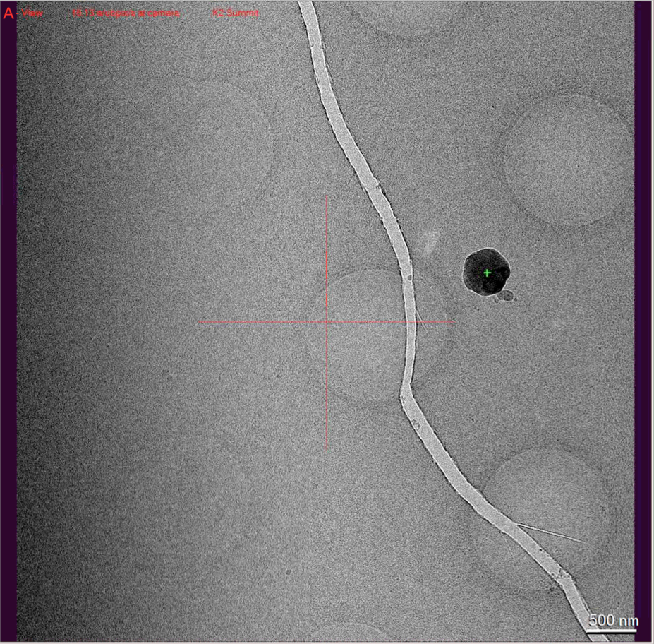

Slide 15
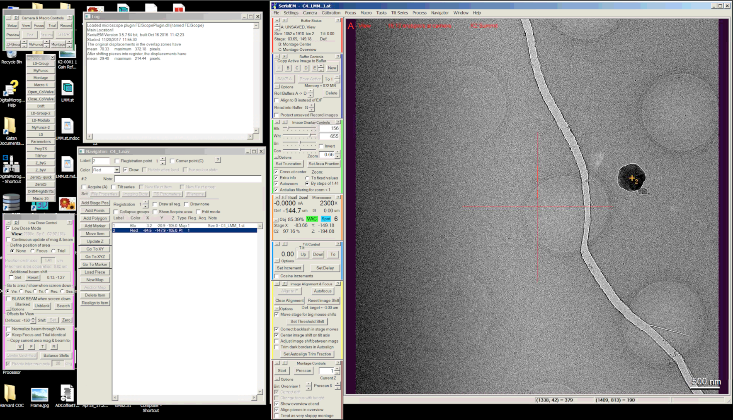
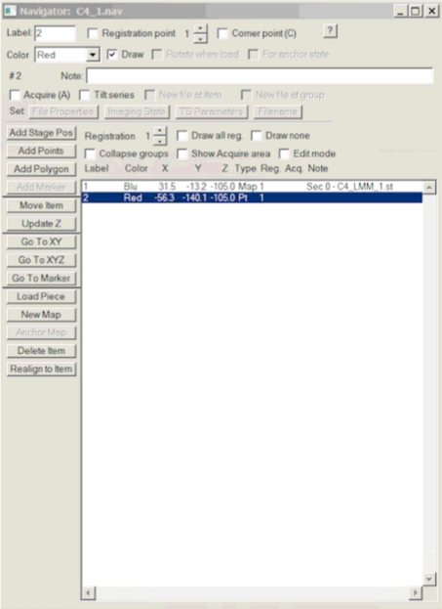
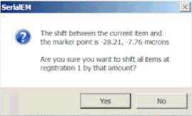

Slide 16
Acquire medium-mag montage
Procedure
  Add a polygon
  Find proper area on low-mag montage where you want to collect medium-mag montage
  Add a polygon on one of the representative grid square
  Navigator
          Add Polygon
  Click “Stop Adding” to finish
Set up Polygon montage
Navigator
Montaging & Grids
Setup Polygon Montage
Add a point in the center of every grid square where you want to collect a medium-mag montage
Turn on the “Acquire(A)” for the Polygon and all the points you have added
Run Macron “Montage”
Navigator
Acquire at Points Run micro # (Montage)

Slide 17
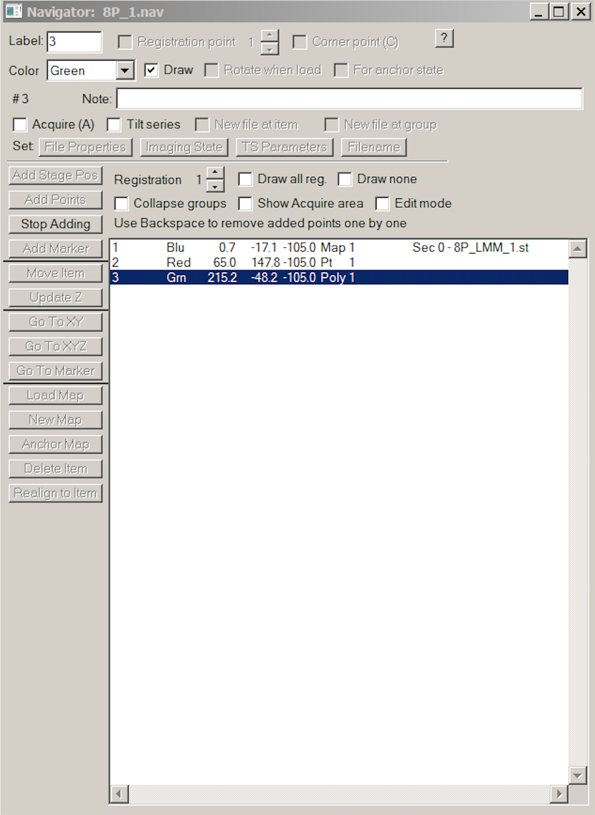
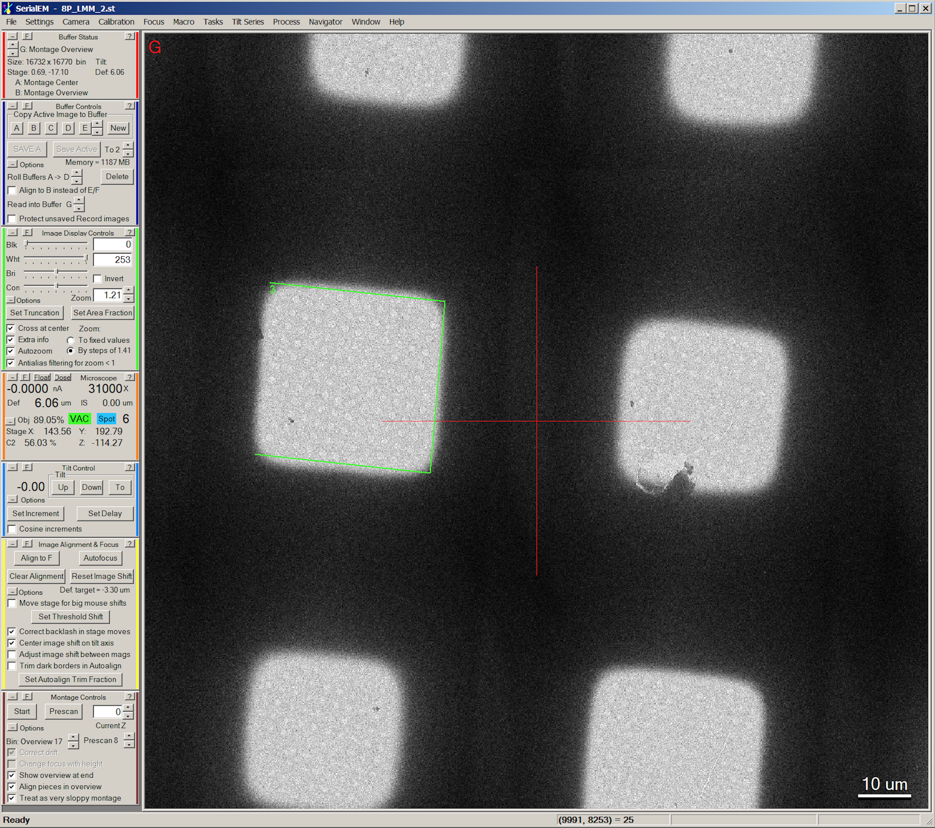
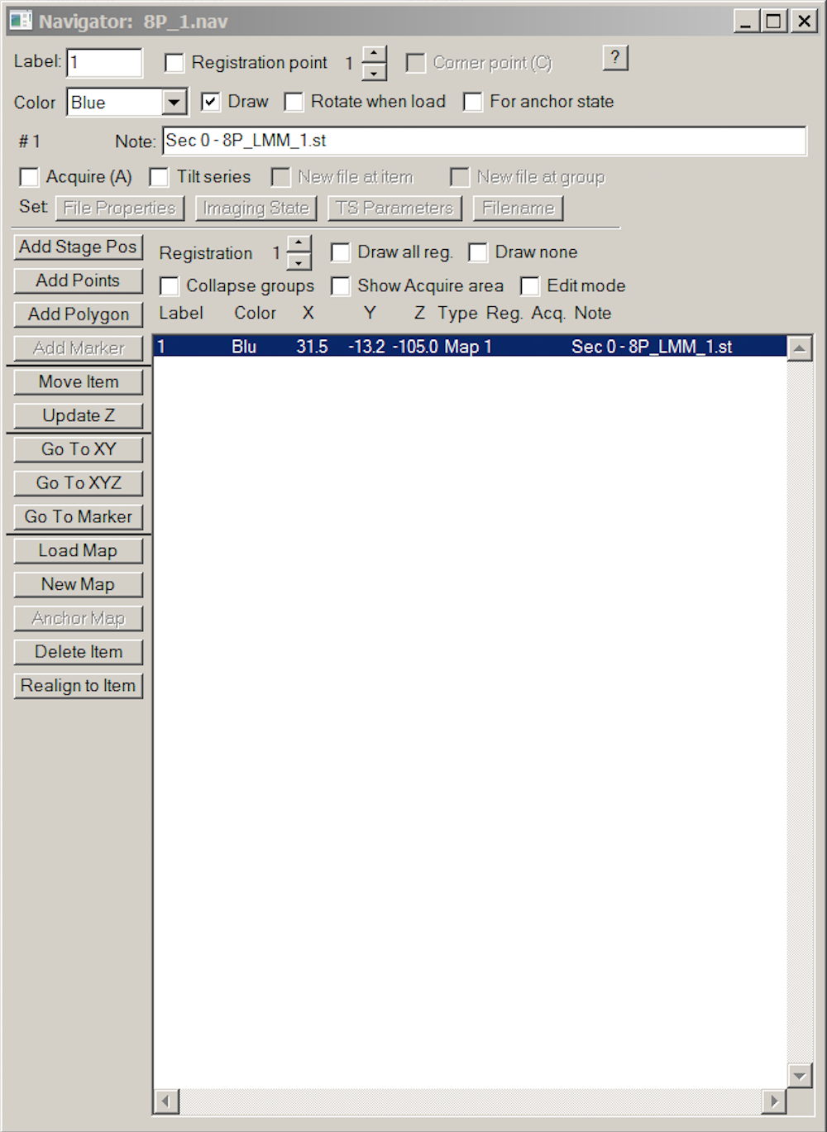

Slide 18
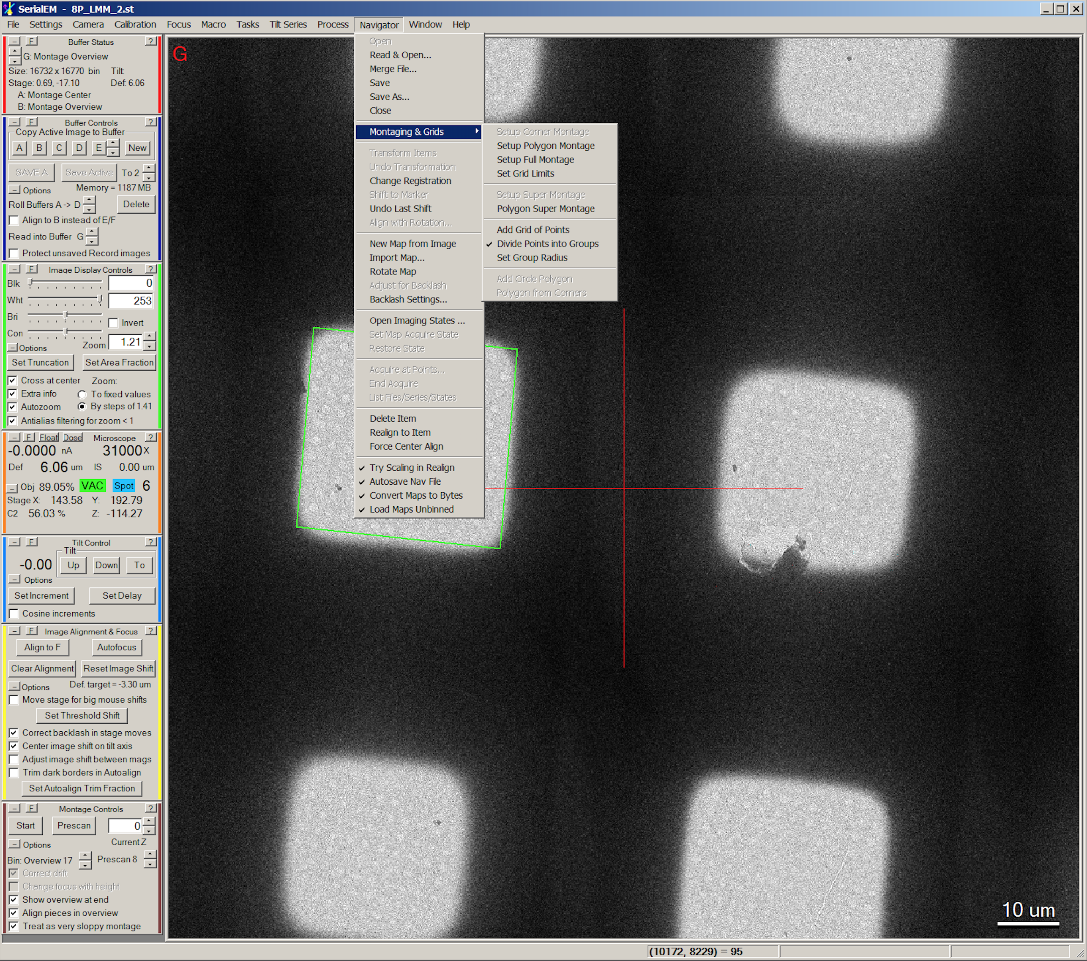

Slide 19
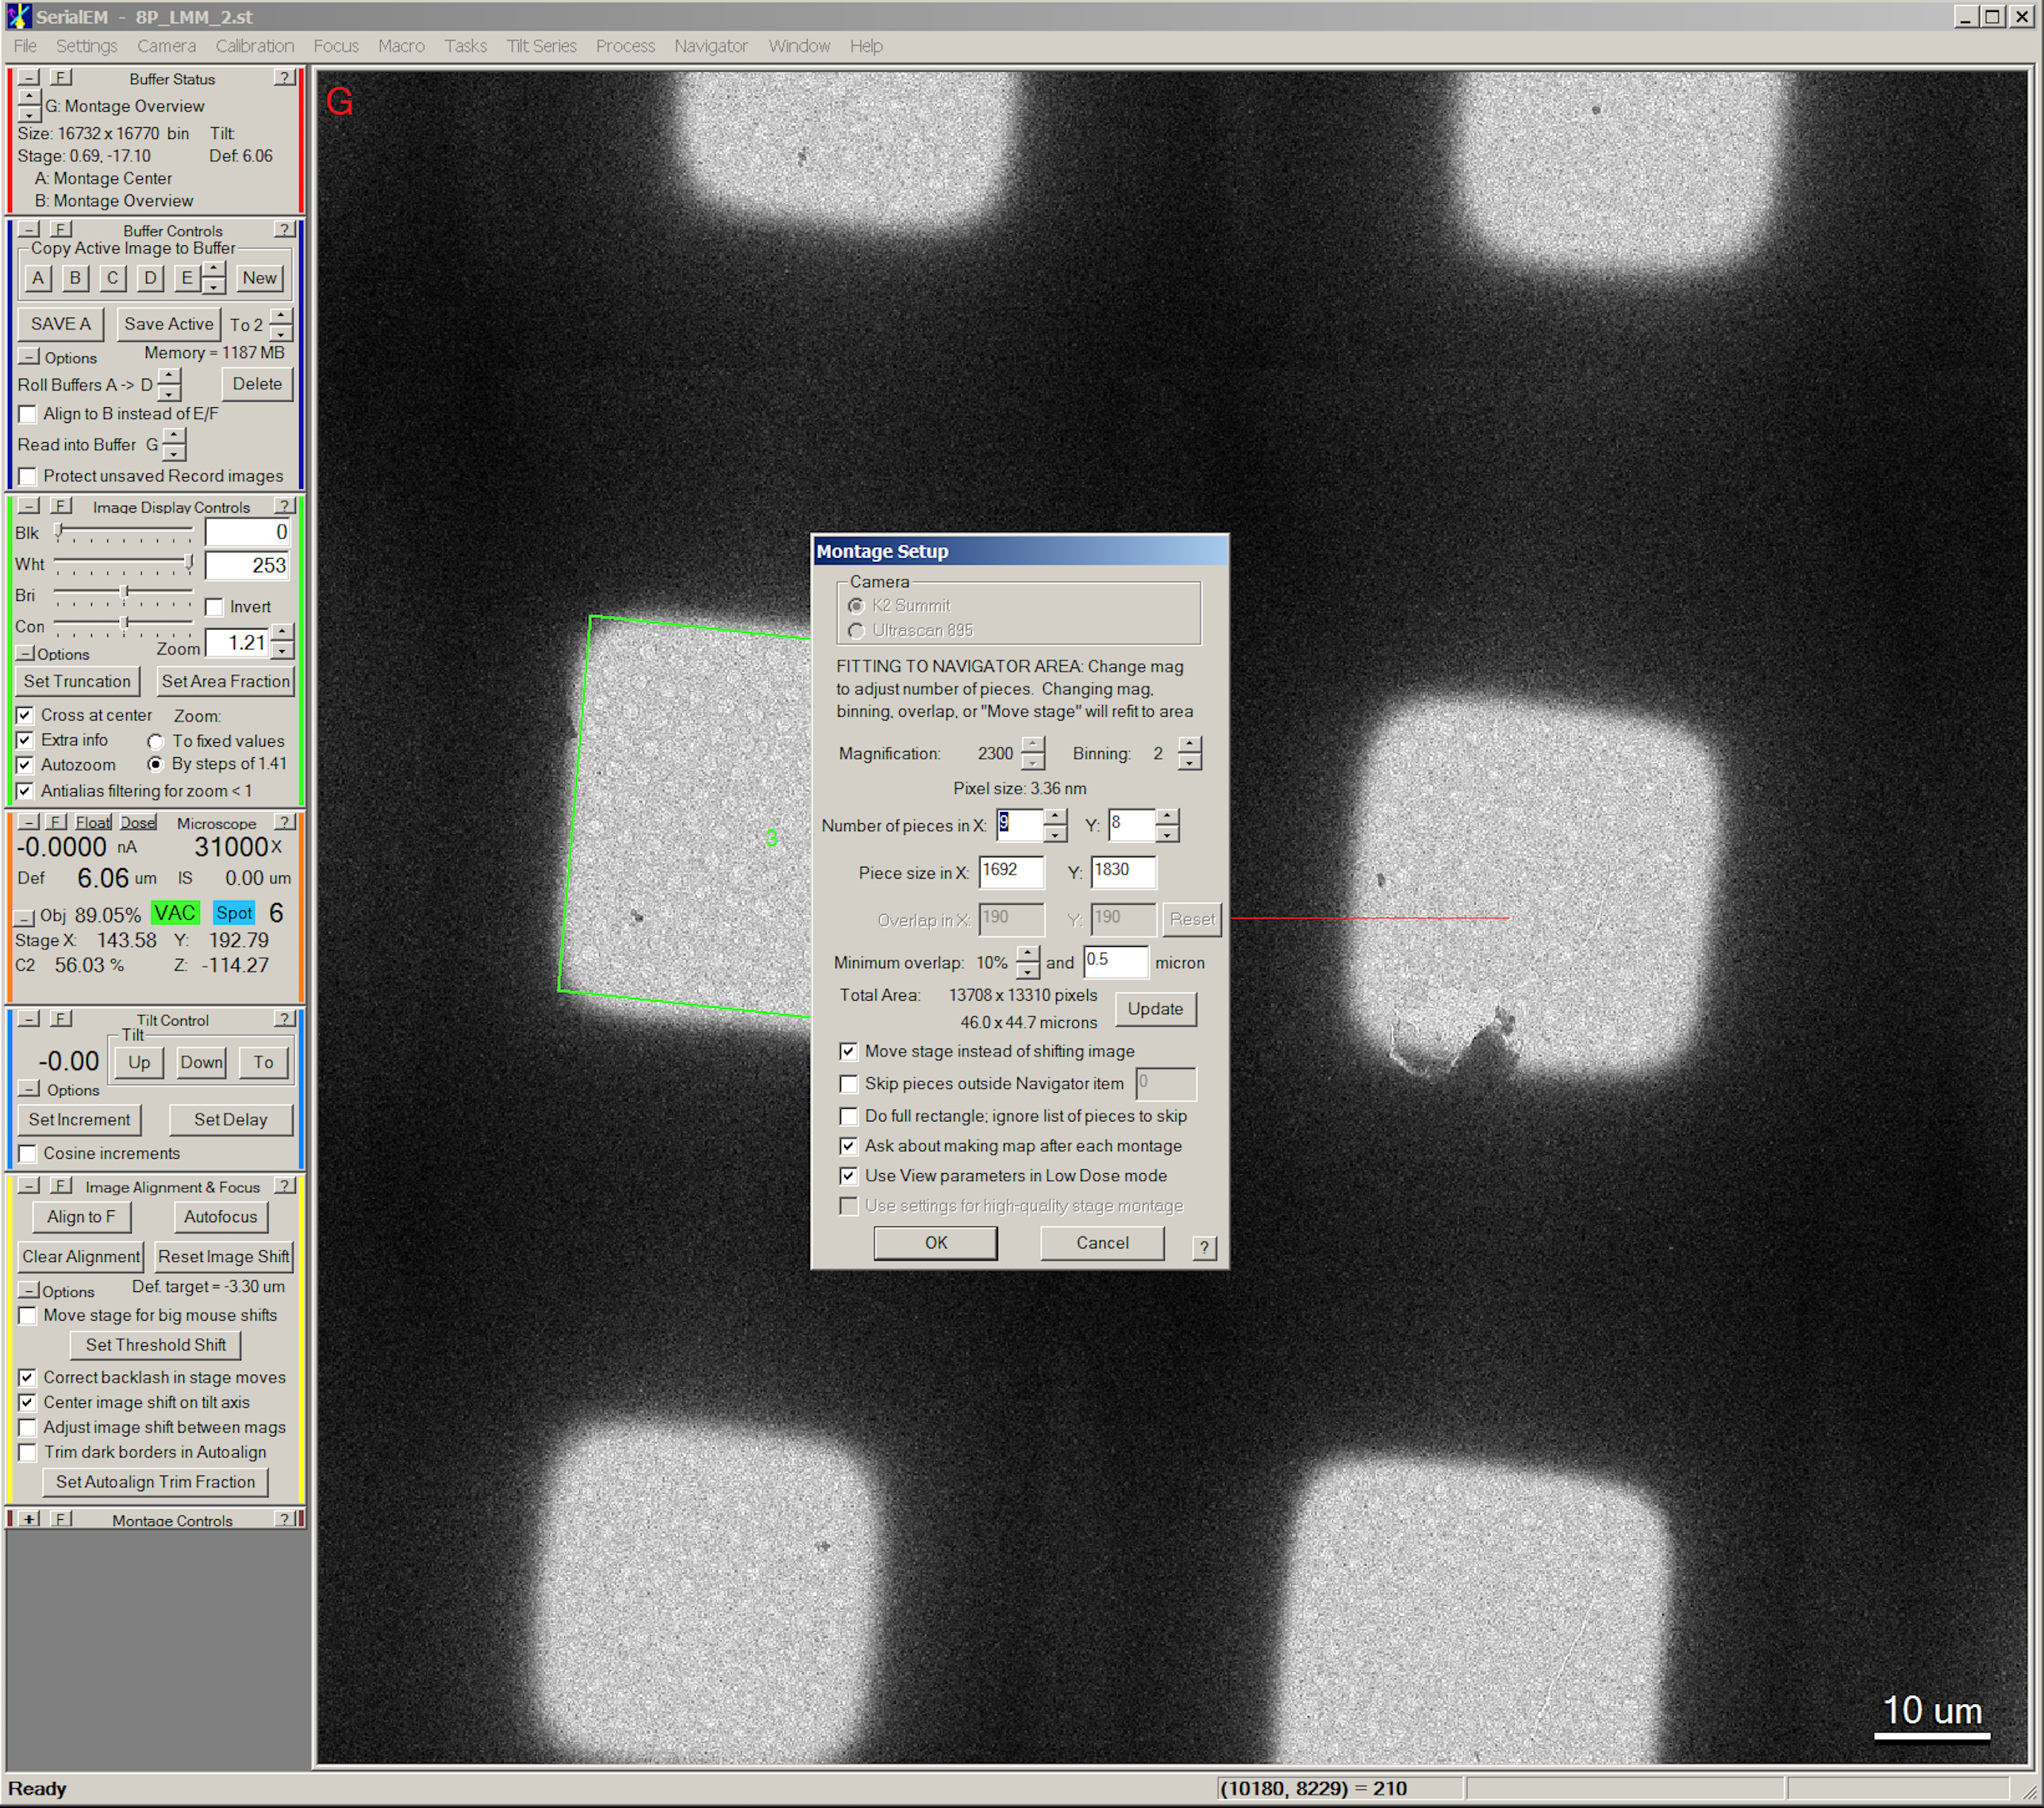
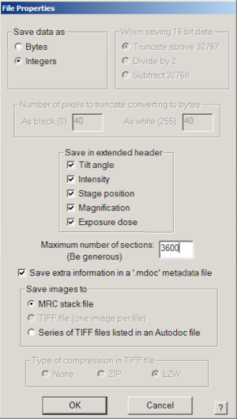

Slide 20
Acquire medium-mag montage
Procedure
  Add a polygon
  Find proper area where you want to collect media-mag montage
  Add a polygon on one of the representative grid square
  Navigator
          Add Polygon
  Click “Stop Adding” to finish
Set up Polygon montage
Navigator
Montaging & Grids
Setup Polygon Montage
Add a point in the center of every grid square where you want to collect a medium-mag montage
Turn on the “Acquire(A)” for the Polygon and all the points you have added
Run Macron “Montage”
Navigator
Acquire at Points Run micro # (Montage)

Slide 21
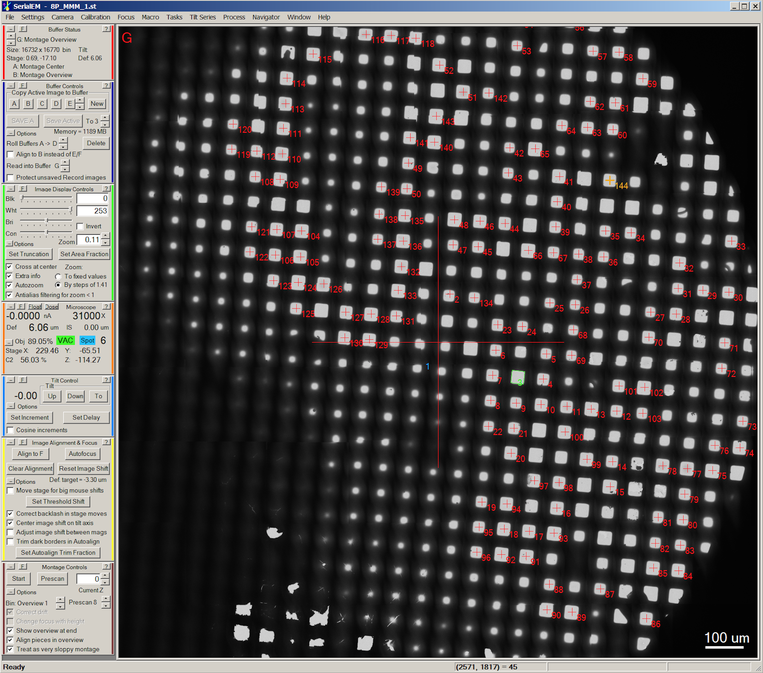

Slide 22
Acquire medium-mag montage
Procedure
  Add a polygon
  Find proper area where you want to collect media-mag montage
  Add a polygon on one of the representative grid square
  Navigator
          Add Polygon
  Click “Stop Adding” to finish
Set up Polygon montage
Navigator
Montaging & Grids
Setup Polygon Montage
Add a point in the center of every grid square where you want to collect a medium-mag montage
Turn on the “Acquire(A)” for the Polygon and all the points you have added
Run Macron “Montage”
Navigator
Acquire at Points Run micro # (Montage)

Slide 23
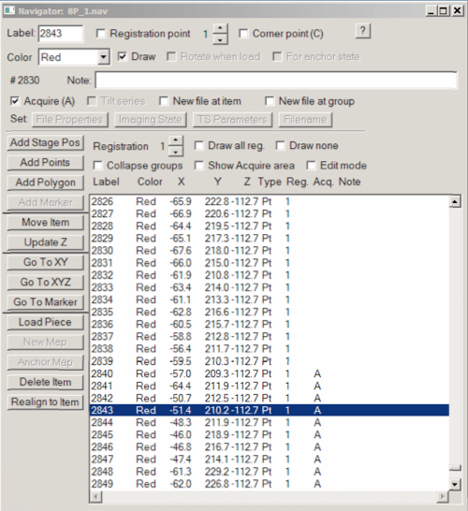
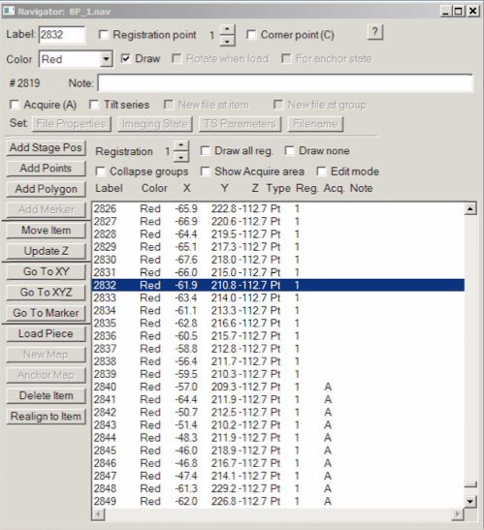

Slide 24
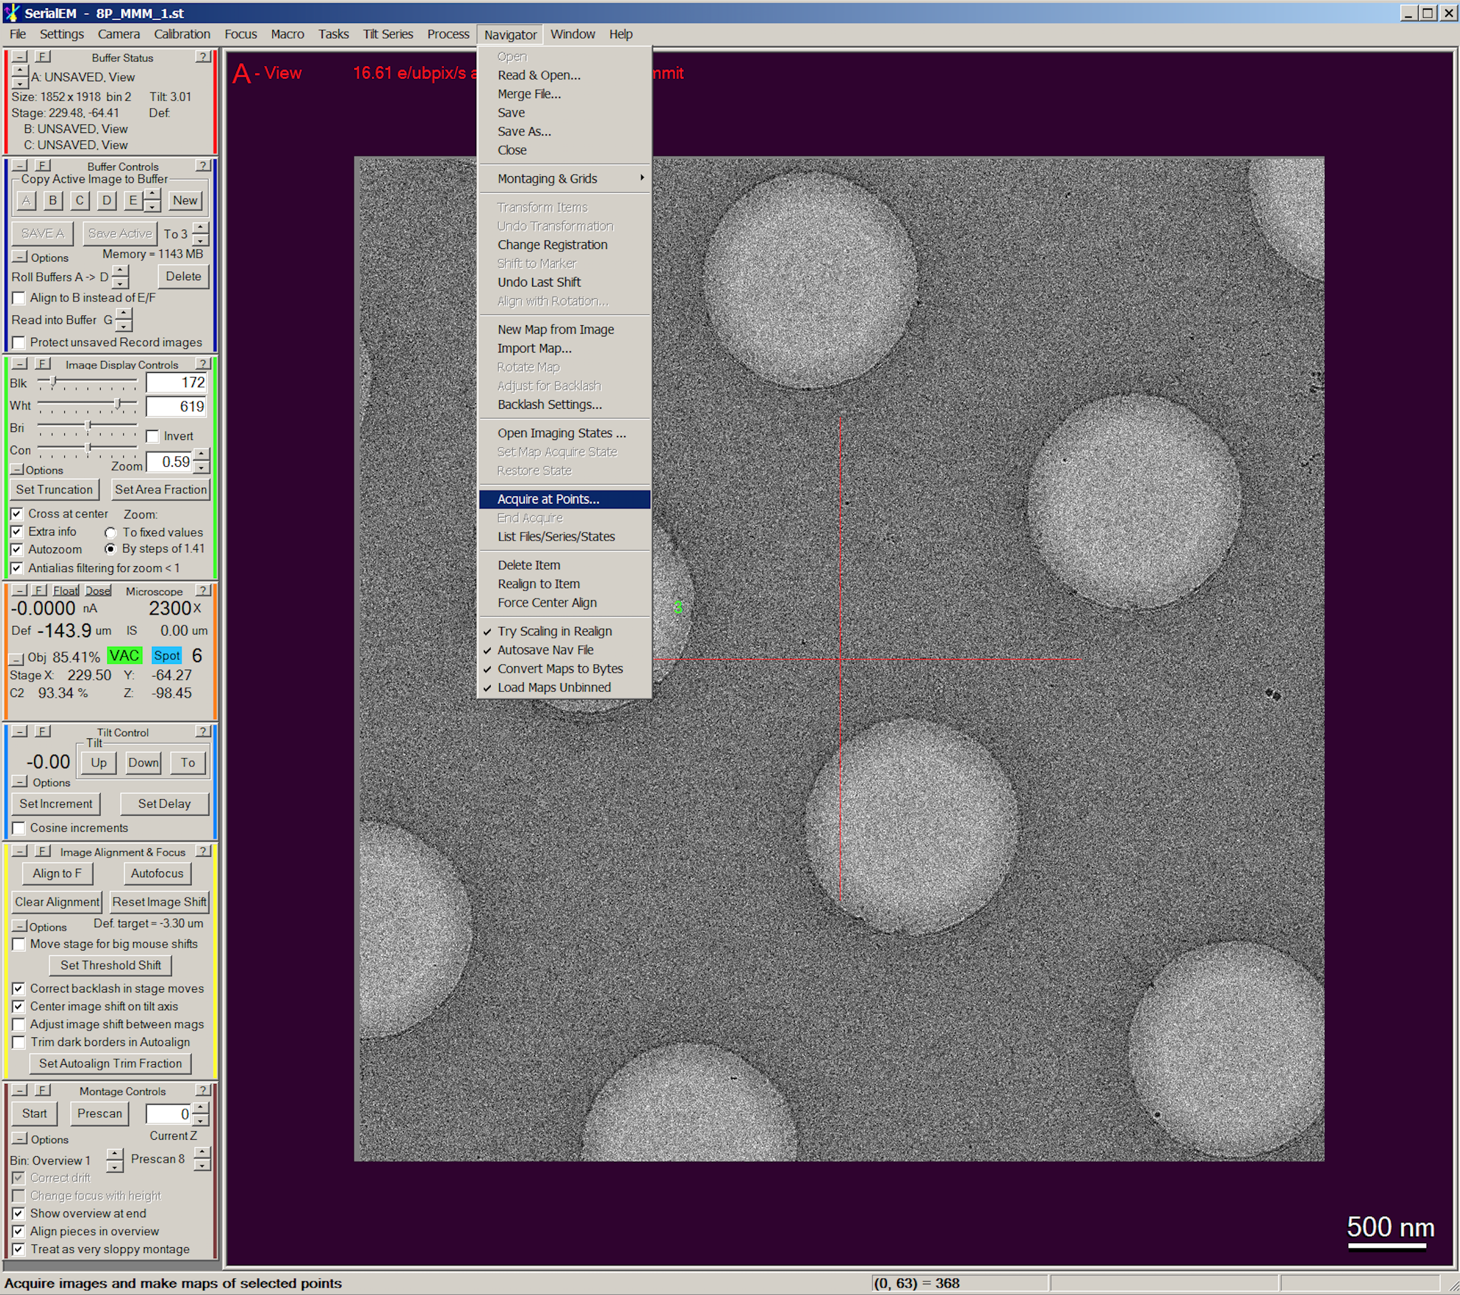

Slide 25
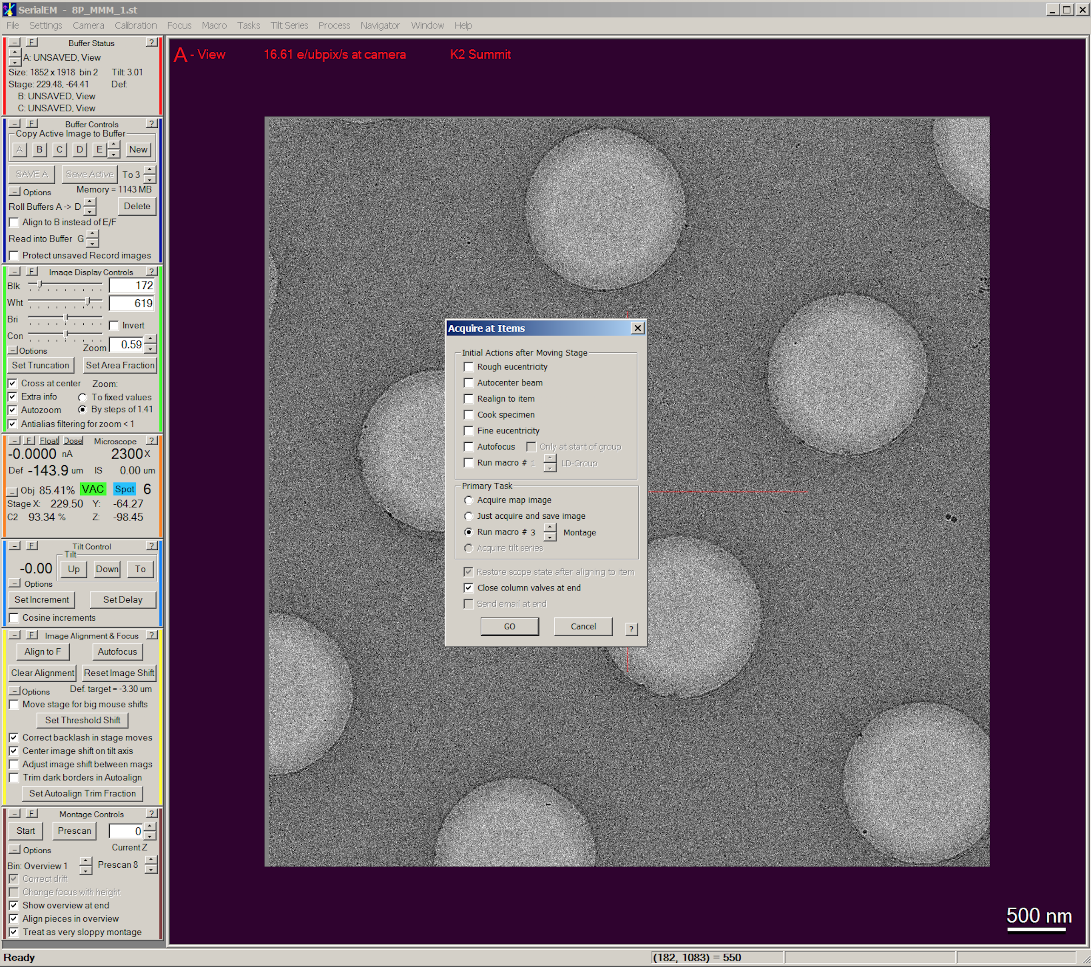

Slide 26
Align the View with Record
Procedure:
In the “Image Alignment & Focus” control panel, un-check “move stage for big mouse shifts”.
Find a feature in record image (e.g. a piece of dirt or contamination) that is recognizable in view image
Hold down the right mouse button to drag the feature to the center of the cross and take a new image. Repeat this until the feature is in the center of cross.
Take a view image, hold down the right mouse button to drag the feature to the center of cross.
On the “Low Dose Control” panel, click the Shift “Set” button under the “Offsets for View”. The new view image will be taken.
Repeat 4 & 5 until the feature on the new view image is in the center
Check “move stage for big mouse shifts”.

Slide 27
Add point on medium-mag montage
Procedure:
Open a medium-mag montage by double click on it.
Group adding:
  Click “Add Point” on Navigator window
  Manually add 5 points on the map, 3 of them for direction and other 2 for distance
  Click “Stop adding”
  Under the Navigator Tab:
  Navigator
  Montaging & Grids
  Add Grid of Points
  Enter the label of the polygon, and then turn on the acquire for the points added
Single adding:
  Click “Add Point” on Navigator window
  Manually add points on interested holes
  Click “Stop adding”
  Turn on the acquire for the points added

Slide 28
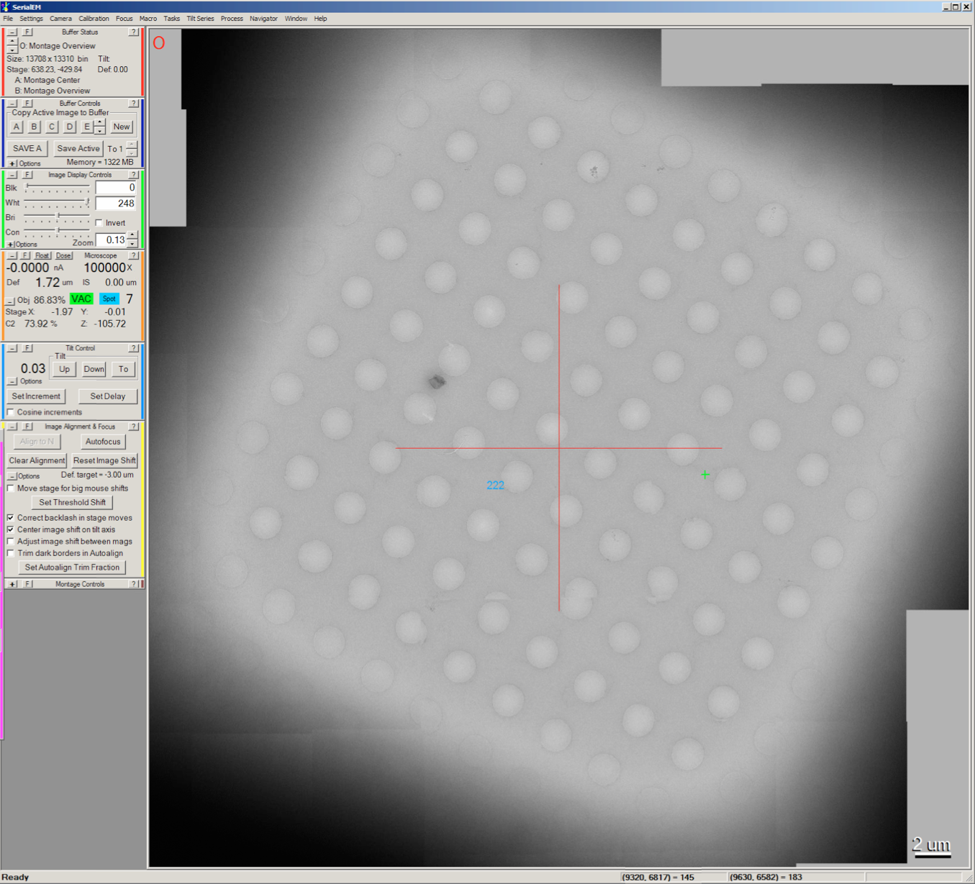

Slide 29
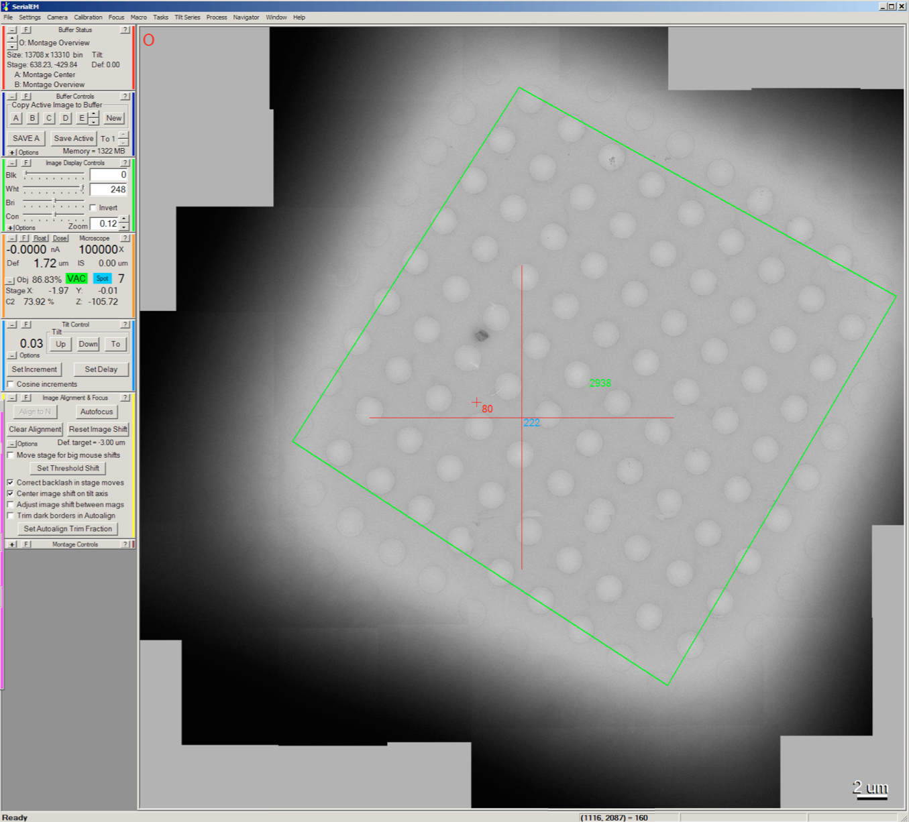

Slide 30


Slide 31
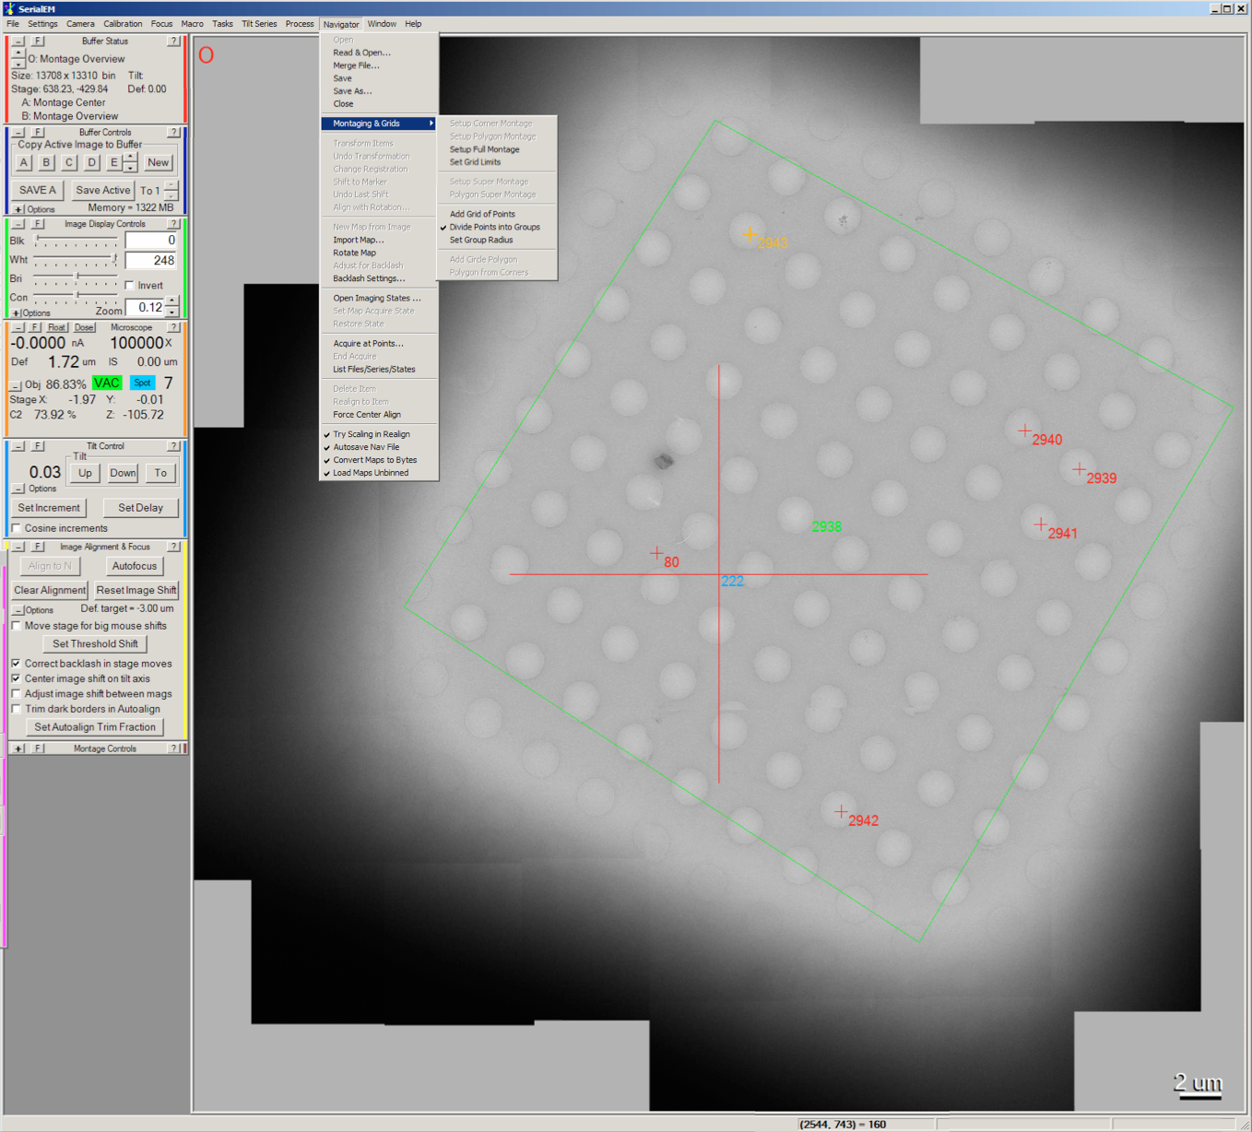

Slide 32
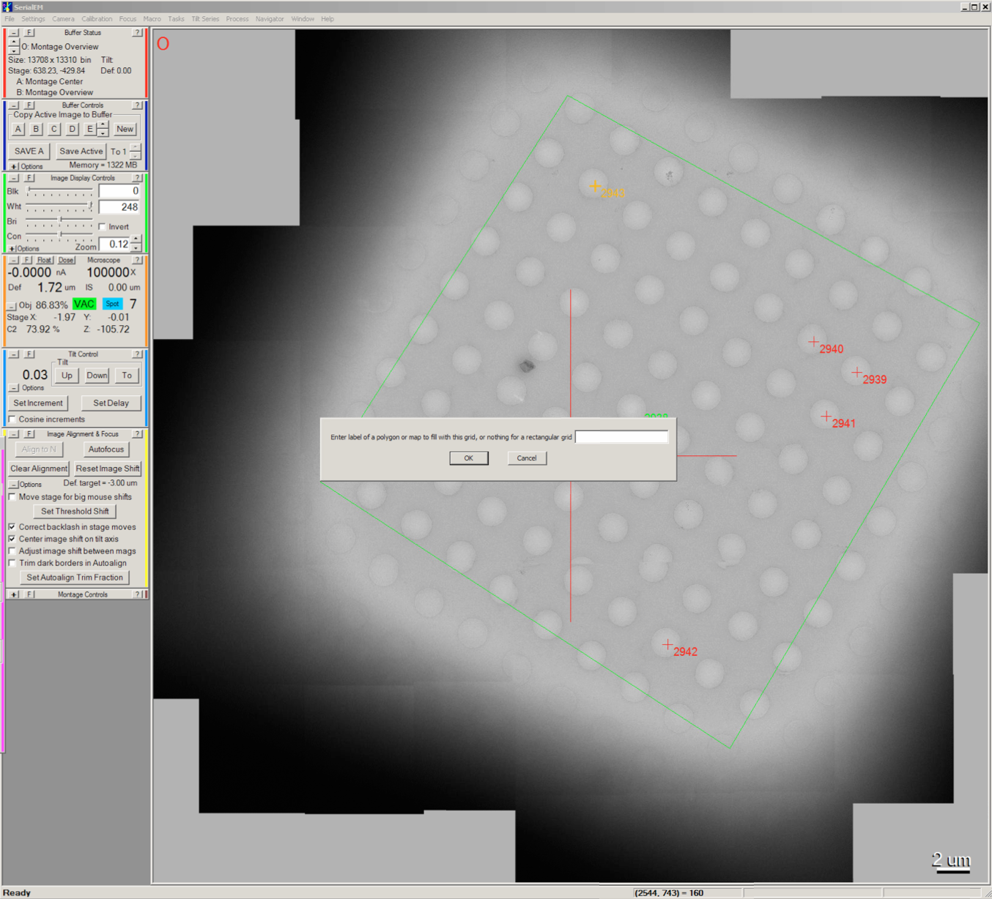

Slide 33
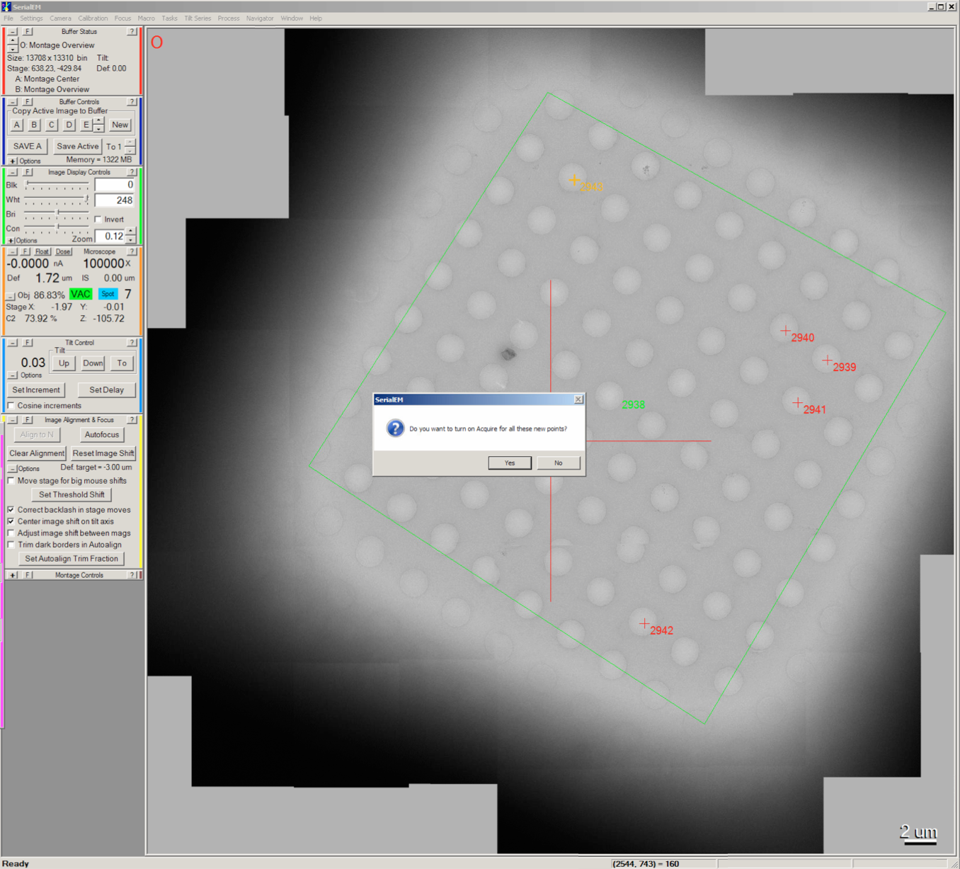

Slide 34
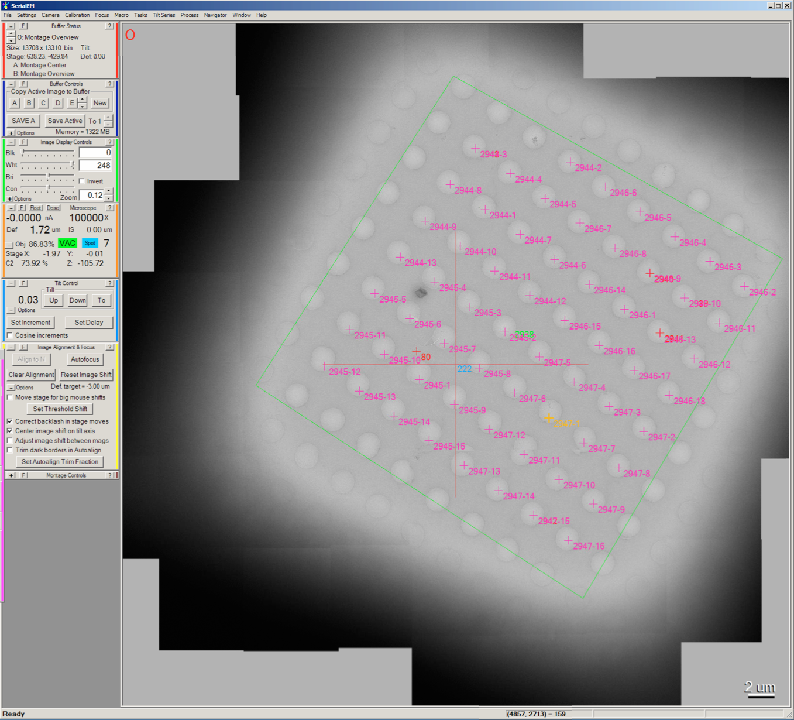

Slide 35
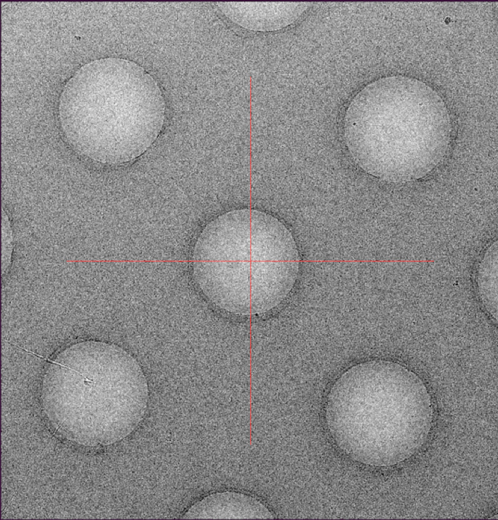
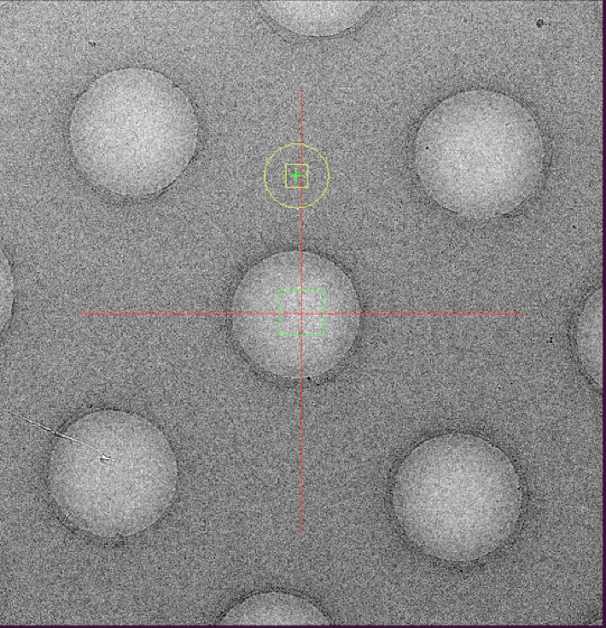
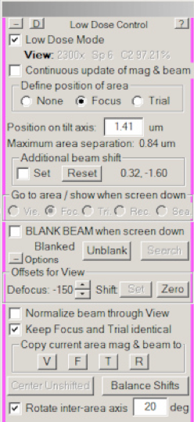
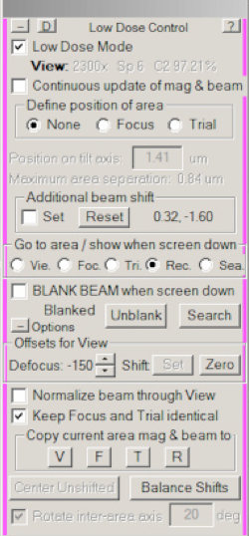
Define focus area
On Low Dose Control panel
Define position of area
Focus

Slide 36
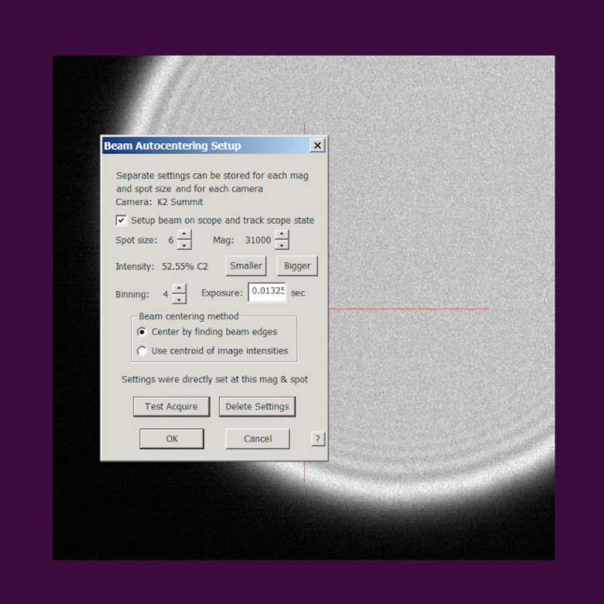
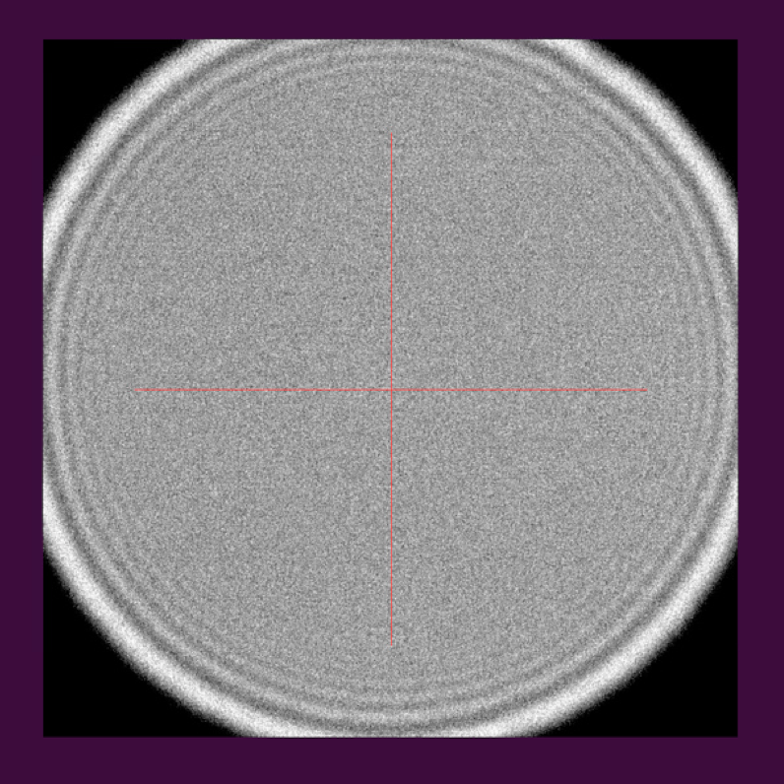
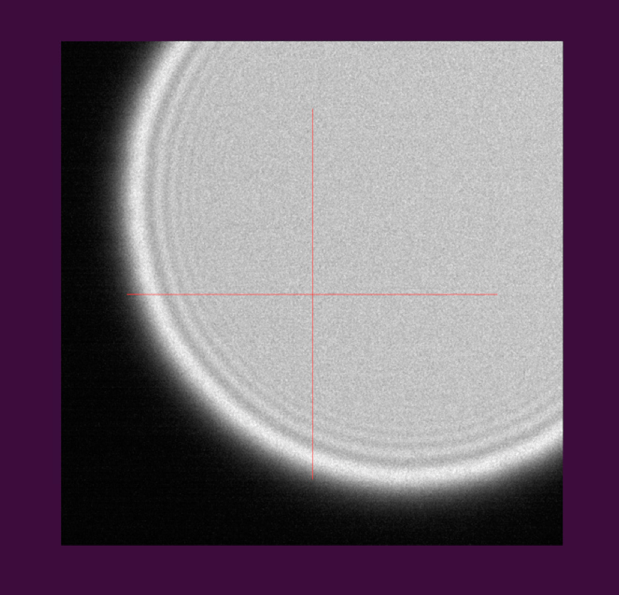
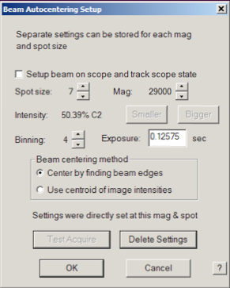
Set up Auto-center beam
Procedure:
  Under the Tasks menu:
  Tasks
  Set up Autocenter beam

Slide 37
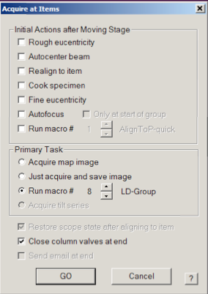
Run macro for collecting images at the points
Procedure:
  Under the Navigator Tab:
  Navigator
  Acquire at points Run macro # (LD-group)

Slide 38
A few notes when using serialEM for data collection
Microscope alignment
  Update z height
  Beam tilt pivot point
Gatan k2 gain refrences
  Gain reference is good for ~ 1 week
  Dark gain reference needs to be prepared more frequently (every ~4 hours)

